Slide 1

Artificial Intelligence Inspired Zero Trust Model for Decentralized Edge Environment
E/16/242 - Saubhagya Munasinghe
E/16/286 - Nuwan Piyarathna
E/16/399 - Erandana Wijerathne
Supervisors - Dr.Upul Jayasinghe , Dr. Namal Karunaratne
Group 10

Slide 2








Security Model
Traditional Architecture
Novel Architecture
Security perimeter surrounds the organization
Security based on the identity, not the perimeter

Slide 3
Zero Trust Architecture
Trust is never granted implicitly but must be continually evaluated.
1
Guaranteeing secure access to all resources
Fundamental Principles
2
No implicit trust based on location
3
Continuous verification

Slide 4
Data Set - Record Distribution
Normal | 2,218,761
Fuzzers | 24,246
Analysis | 2677
Backdoors | 2329
DoS | 16,353
Exploits | 44,525
Generic | 215,481
Reconnaissance | 13,987
Shellcode | 1511
Worms | 174
Total no of records : 2,540,044
Dataset : UNSW-NB15

Slide 5



Final trust value
x9 high level trust metrics
x9 machine learning models
Select best n features out of 47 for each attack
X47 low level features

Slide 6
Data Preprocessing
1
2
Data cleaning (Null, Missing, hex values)
Creating attack-wise labels
3
4
Encode the categorical data
Split data set into 3 (60%,20%,20%) for train ,test and online learning

Slide 7
Feature Selection
Remove features with High correlation
Used variable threshold method identify constant features
1
3
5
2
4
Used Information gain to reduce features
Chi-Square statistical Analysis
Remove features that has high missing value percentage

Slide 8


Dos Attacks - Procedure

Slide 9
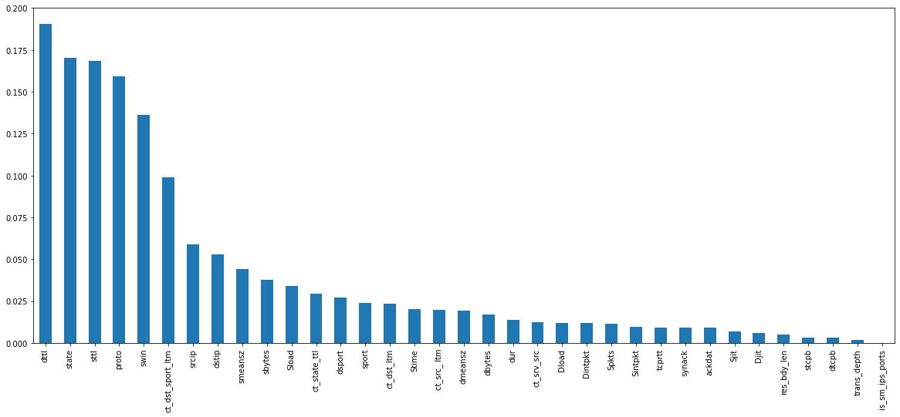
Information Gain
Selecting Best N features

Slide 10
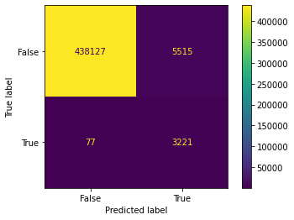
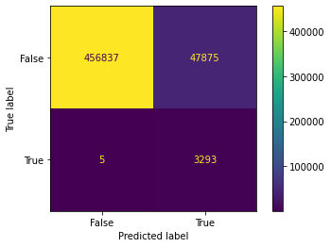
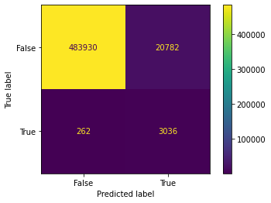
Comparing Accuracy with N
Features : 15
Accuracy : 98.74%
Threshold : 0.6
Features : 5
Accuracy : 90.57%
Threshold : 0.8
Features : 10
Accuracy : 95.83%
Threshold : 0.6
Algorithm - Random Forest

Slide 11
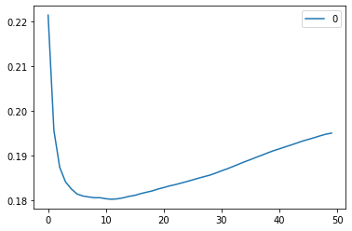
Hyper Parameter Tuning
Variation of error rate with different K (neighbours)
Algorithm - K-Nearest Neighbours

Slide 12
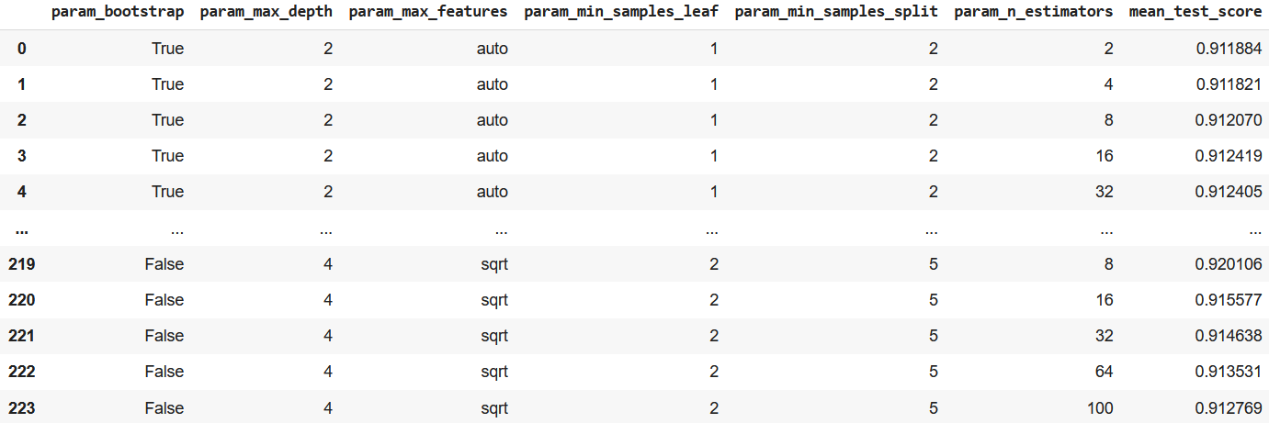
Hyper Parameter Tuning
GridSearchCV - create a grid of hyper-parameters and try all of their combinations
Algorithms - Random Forest, Isolation Forest, SVM, One-class SVM

Slide 13
Creating a Balanced Dataset
Problem
Low no of records for attacks and higher no of normal records
Initial unbalanced dataset
Methods
Upsampling
Downsampling
Trying anomaly detection algorithms

Slide 14
Machine Learning Algorithms
Anomaly Detection Algorithms
Logistic Regression
Decision Tree Regressor
Random Forest Regressor
K Nearest Neighbors Regressor
Deep Neural Network
SVM Regressor
Isolation Forest
One Class SVM

Slide 15
Algorithms with Best Performance
Attack Type | Algorithm | F1 Score | Accuracy
DoS | ANN | 0.8655648322 | 99.82
Analysis | Random Forest | 0.6925150559 | 99.44
Backdoors | ANN | 0.5720698254 | 99.85
Fuzzers | Random Forest | 0.629518477 | 98.17
Exploits | KNN | 0.7912468657 | 98.98
Generic | KNN | 0.9872429594 | 99.76
Reconnaissance | KNN | 0.6735179847 | 99.41
Shellcode | ANN | 0.424726477 | 99.09
Worms | KNN | 0.450439882 | 98.47

Slide 16
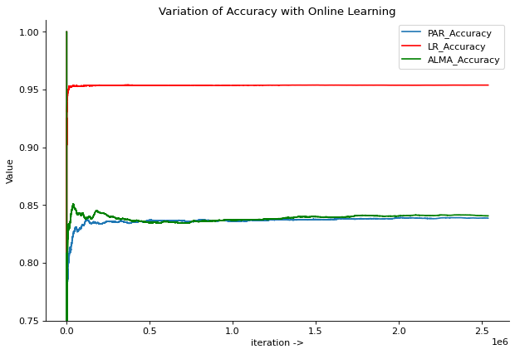
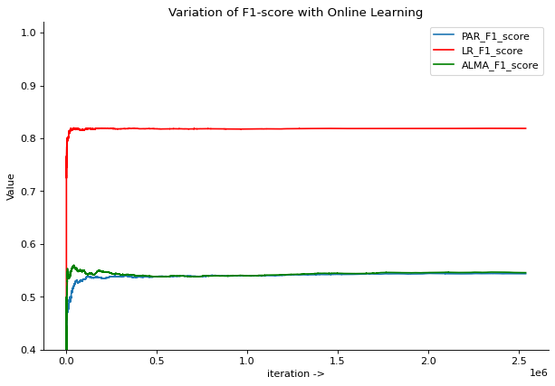
Online Learning
Logistic Regression, Passive-aggressive Classifier, Approximate Large Margin Algorithm Classifier

Slide 17
Q & A

Slide 18








ZTA Big Picture
IP
User Trust
(Identity + Behavior)
Location
Web apps
VMs
Policy Engine
SaaS apps
Policy Enforcement
infrastructure
Device Trust
(Identity + Posture)
Session Age
APIs
Time

Slide 19




Use Case
IXIA Traffic Generator
I₁
I₂
Server 1
Server 2
(Malware)
Server 3
Router 1
Router 2
Detect User Behaviour using ML model
Tcpdump
Clients
Pcap files

